Slide 1
Group Technical Design Project
BMME 298
Edgar Kong, Lamis Hammouda, Eythan Suber

Slide 2
The Problem
People with asthma and other respiratory disorders such as COPD and cystic fibrosis don’t have a reliable method of determining when they are at risk for triggering their respiratory symptoms. Some factors that can indicate respiratory problems include low oxygen levels, high heart rates, high environmental temperatures, and high environment humidity, and other environmental triggers such as pollen, allergies, and low air quality.

Slide 3
A way to detect hazardous biological and environmental conditions to prevent asthmatic and other respiratory symptoms in patients with respiratory health disorders in order to reduce serious hospital visits.
Need Statement

Slide 4
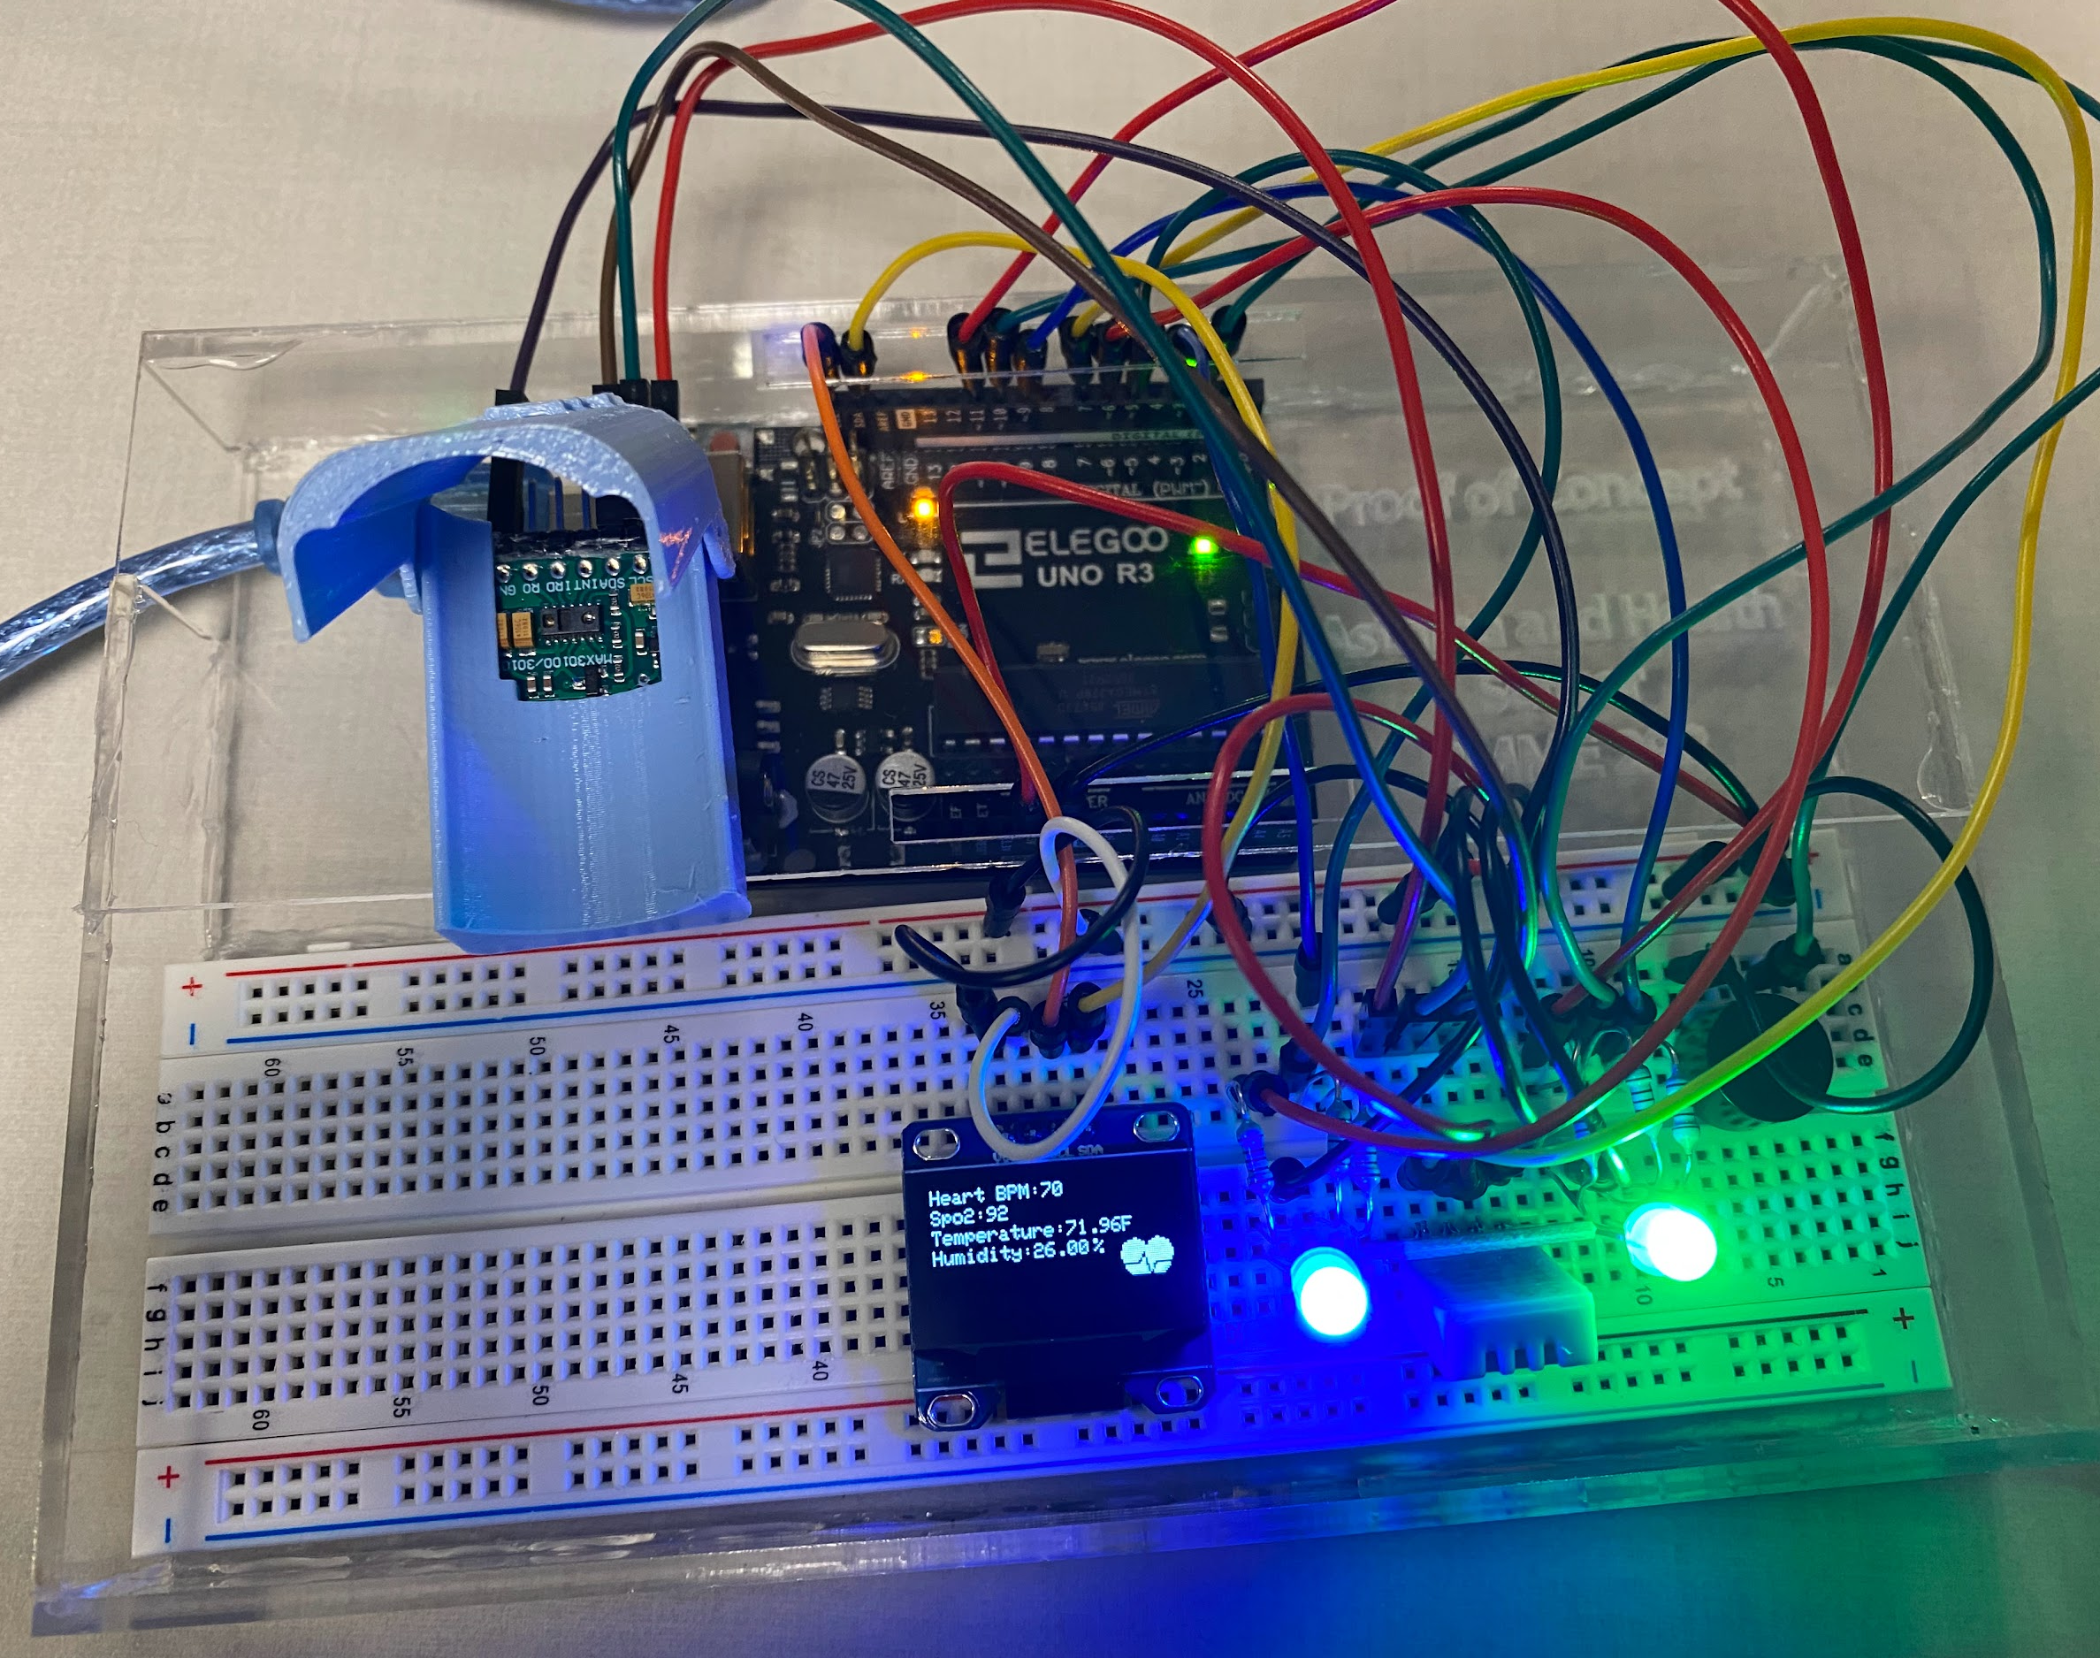
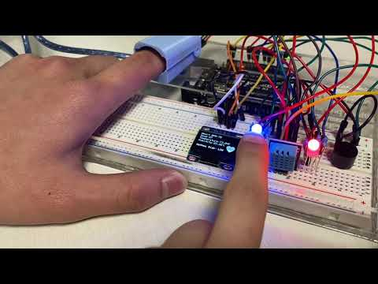
Our Solution
Asthma & Health Sensor
We created a device that senses environmental conditions (temperature & humidity) & patients biological conditions (heart rate & blood oxygen levels) to determine risk level of respiratory issues.
Notes:
Note: the oxygen sensor we ordered had a defect so we had to simulate the oxygen levels using the code.

Slide 5
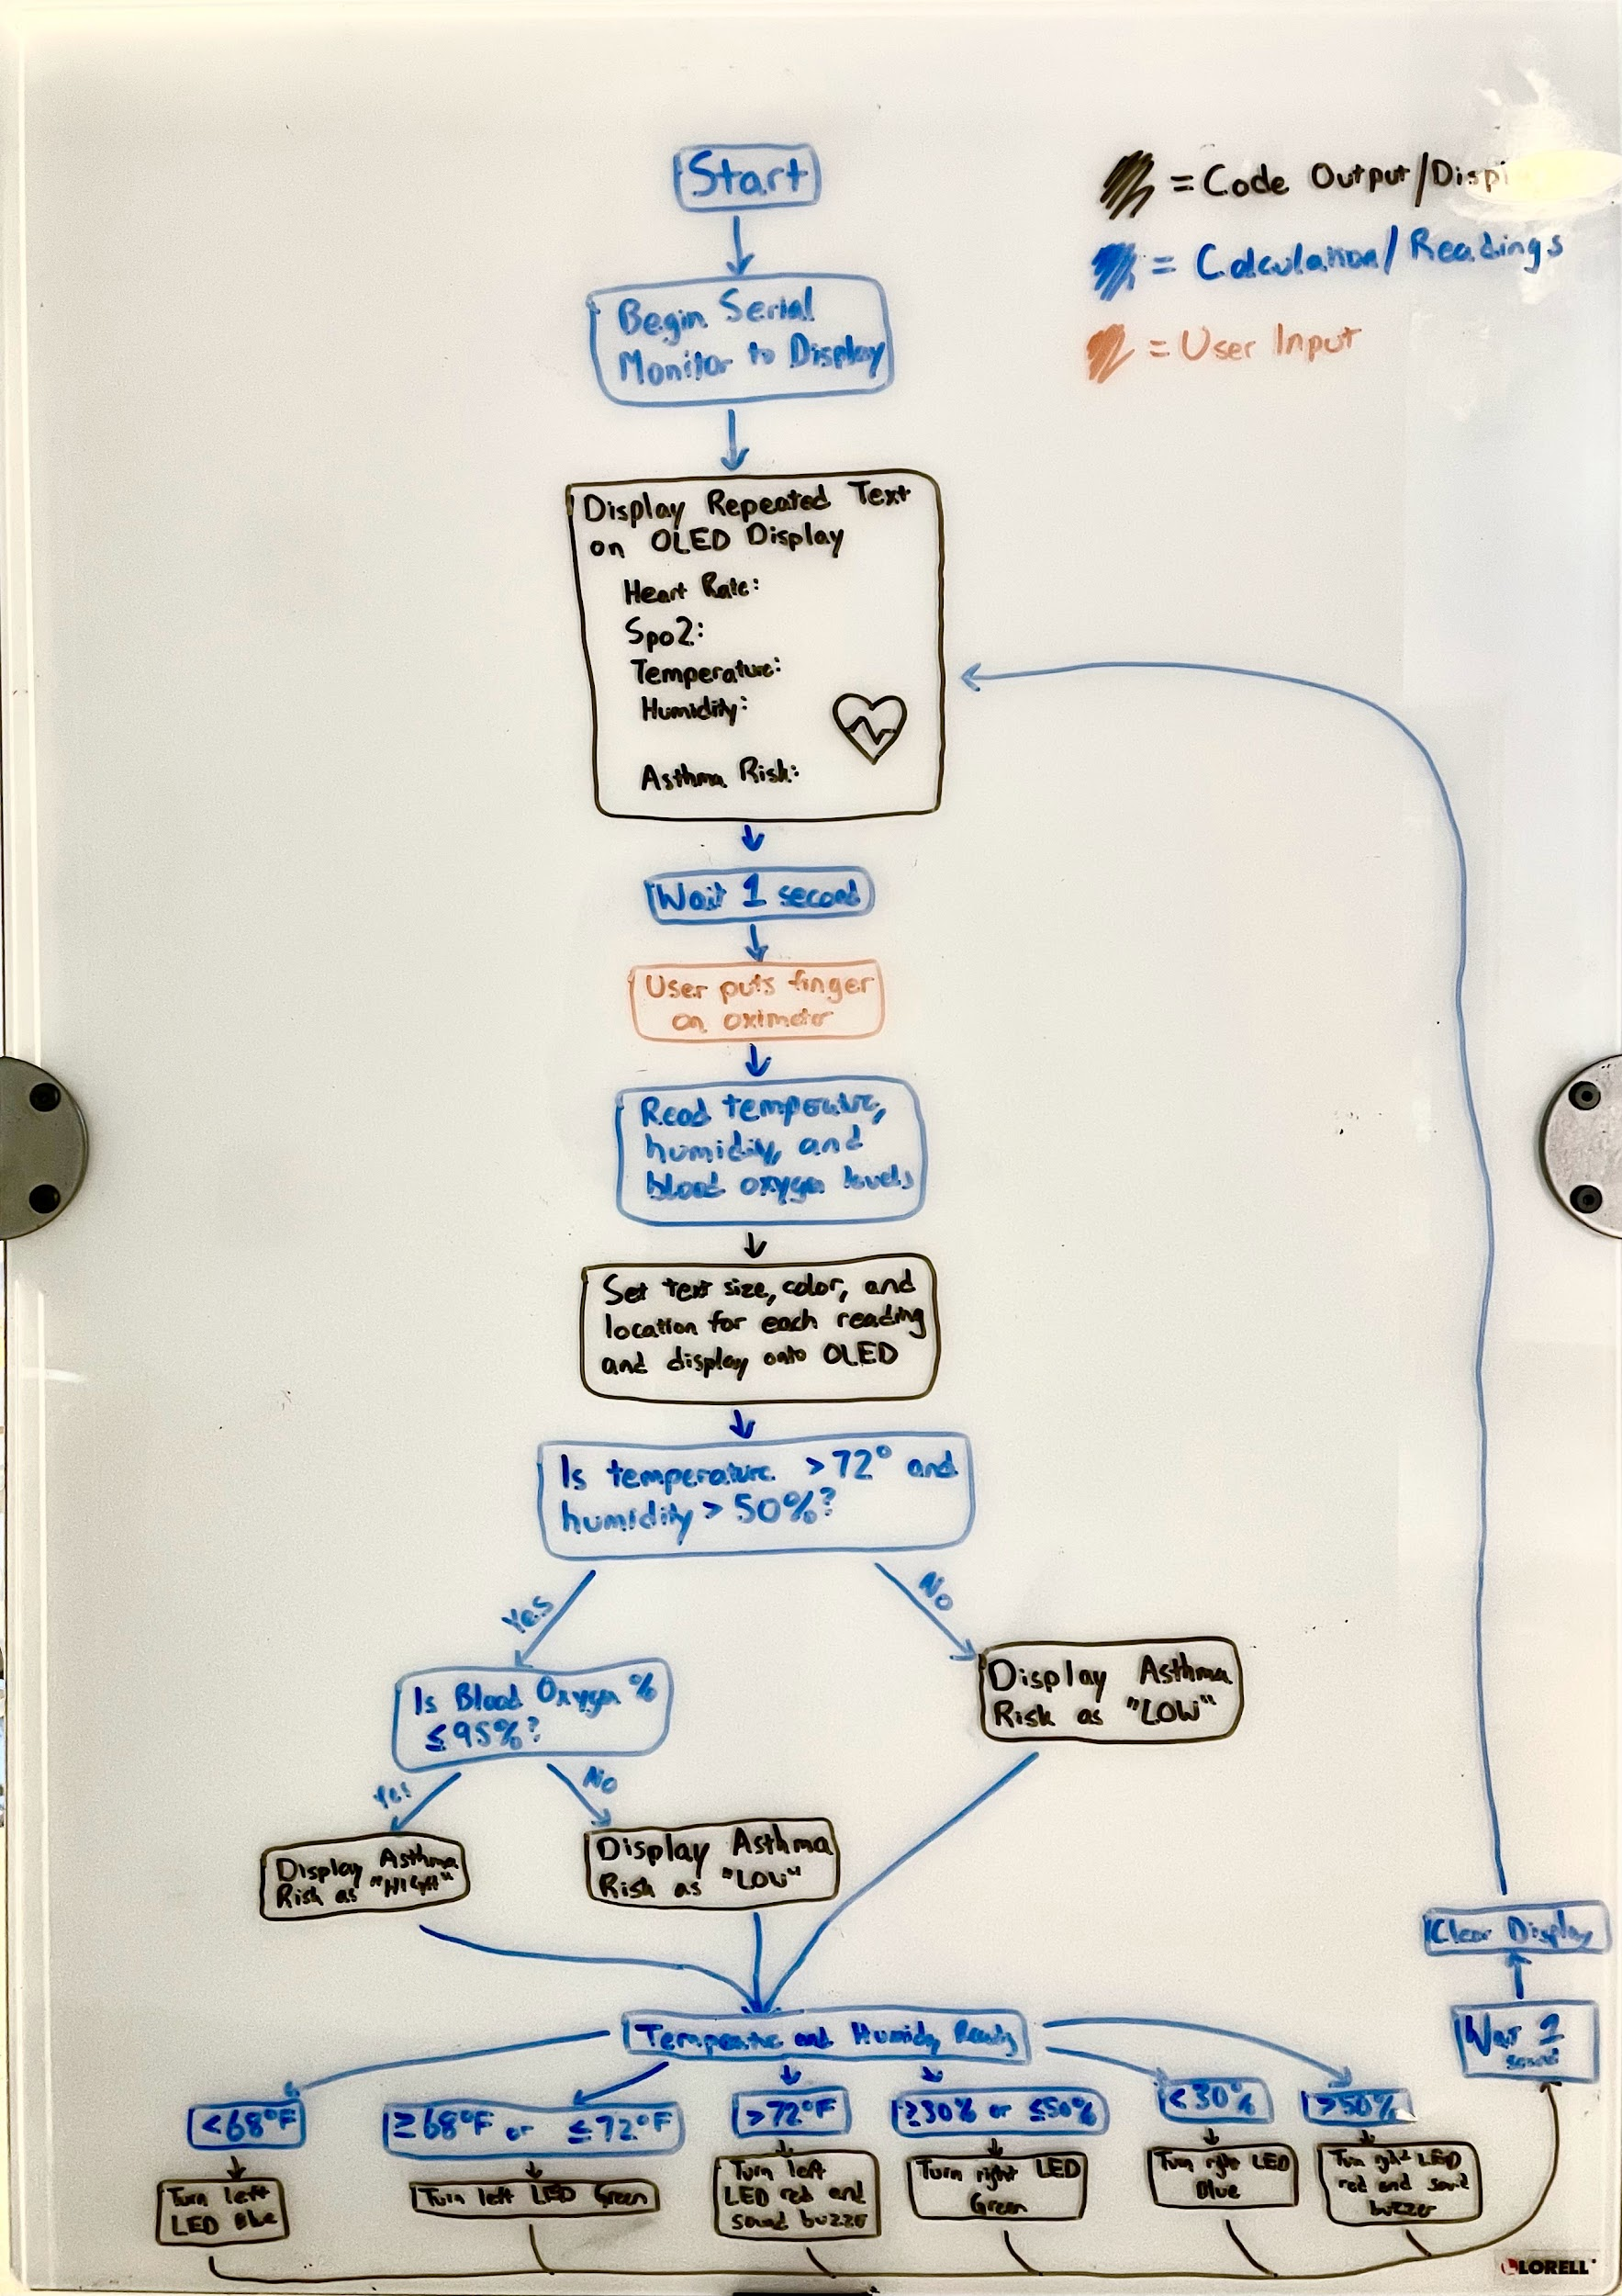
Code Operation

Slide 6
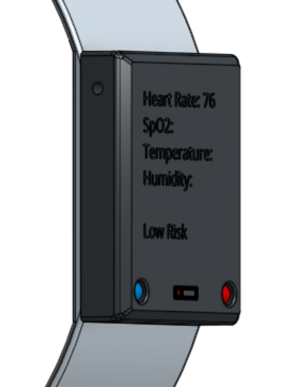

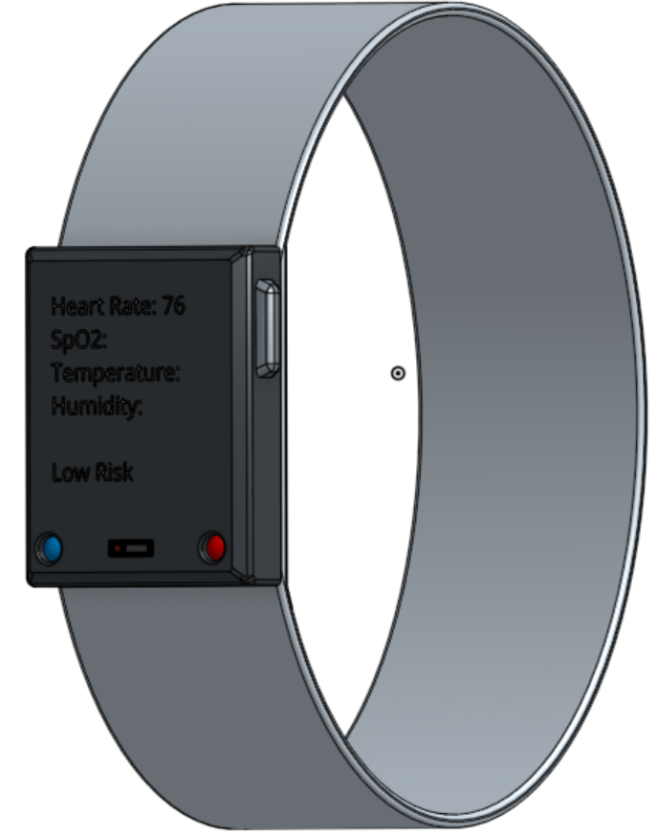
Concept Image
Speaker
OLED Display
Elastic Band
Temp/Humidity
Pulse oximeter made stylish and wearable with an elastic band. Incorporated within an OLED display sits indicator LEDs, an alert speaker, and a temperature and humidity sensor
LED
Pulse Oximeter

Slide 7
Thank you!

